Slide 1
Building new boxes

Slide 2

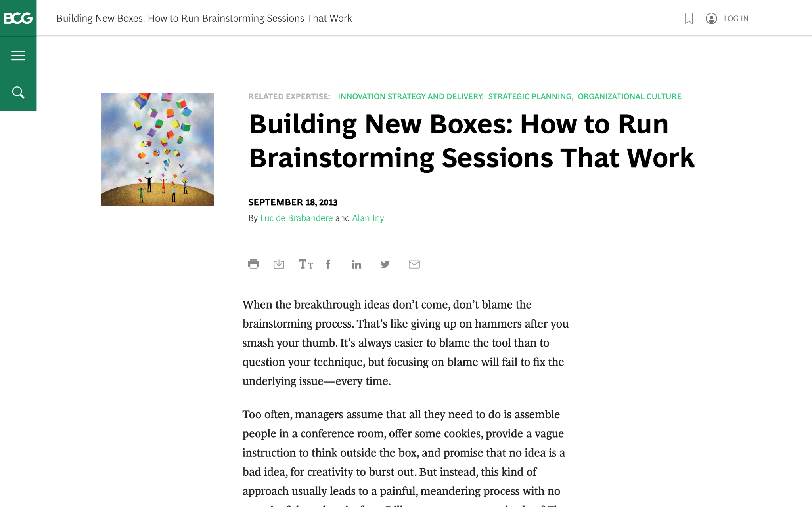
We are going to discuss effective brainstorming. Start by reviewing this article on the BCG website:
Building New Boxes: How to Run Brainstorming Sessions That Work

Slide 3

The article offers five suggestions to achieve real, valuable insights from brainstorming
We will focus on three of these in today’s task (as well as the brainstorming itself), highlighted in green
1.
Frame the question effectively
2.
Create creativity conditions
3.
Reveal and doubt your boxes
4.
Bring new boxes
5.
Follow up
Brainstorm

Slide 4
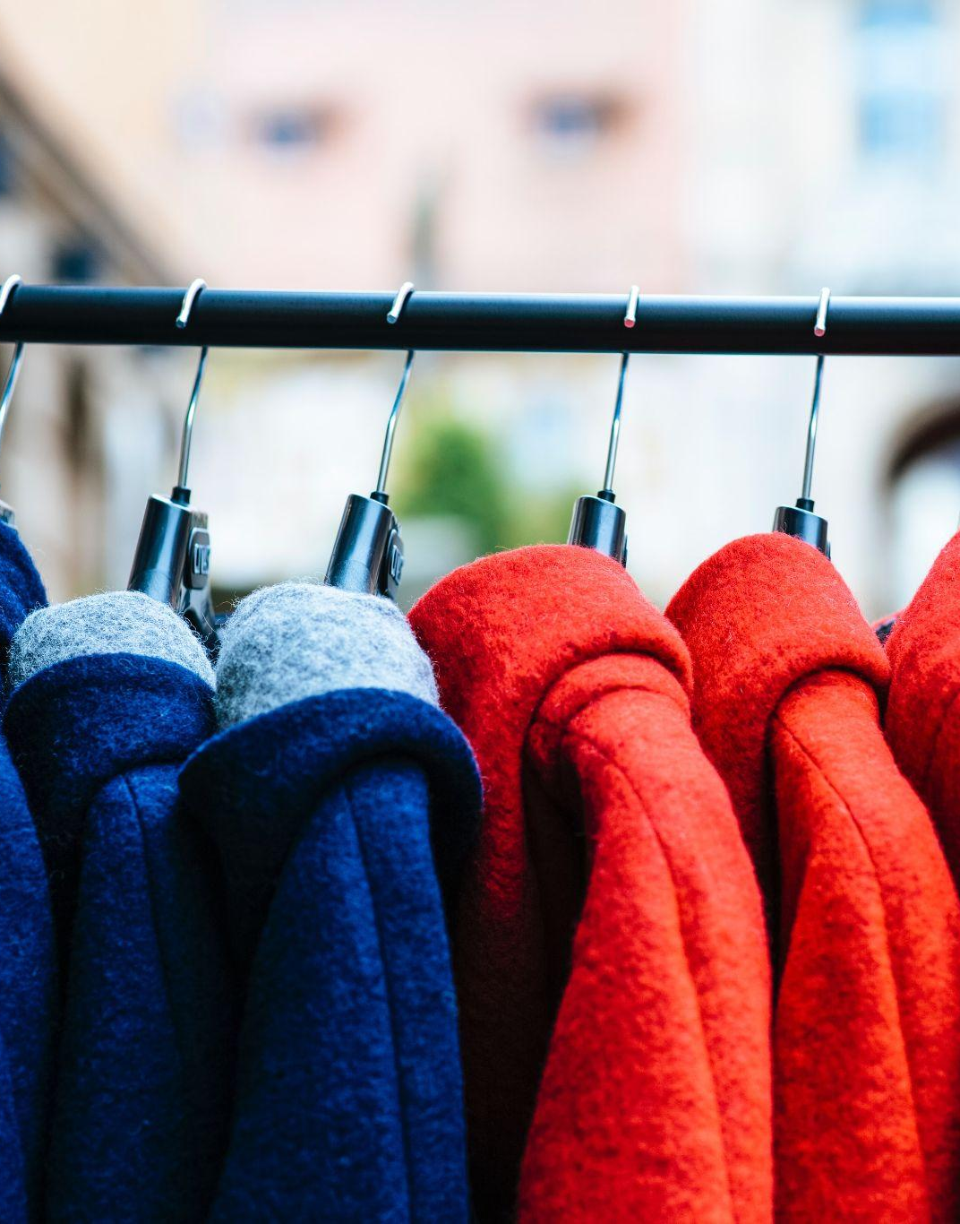
Your task
BCG has been brought in to help ClothingCo, a luxury clothing brand, grow their top line (i.e., increase revenue) after a period of declining sales.
The client is gearing up for the winter season. Imagine that you are a strategy consultant working on the project.
You will enter your responses in the green boxes throughout the remaining slides.

Slide 5
Frame the question effectively
Question to be reframed
How could we sell more outerwear this winter season?
–
Revised, effective questions:
What do our customers really want in winter outerwear?
How can we make our outerwear more desirable?
Where and how can we best reach our customers this winter?
Can we partner with other brands to sell more outerwear?
Remember: A good question for brainstorming will be narrow and concrete, so that people feel they know how to begin answering it.
“If I were given one hour to save the planet, I would spend fifty-nine minutes defining the problem and one minute resolving it.”
– Albert Einstein

Slide 6
Reveal and doubt your boxes
In this fictional scenario, make assumptions that seem reasonable
–
What boxes currently exist that are still relevant?
High-quality materials matter.
Classic designs appeal to customers.
–
What boxes currently exist that need to be doubted?
Our customers are old and rich.
We only sell in fancy stores.
Traditional ads are better than online ads
The first step in the creative process entails identifying and doubting one’s current boxes and determining which ones require re-evaluation or replacement.
Make a short list of the shared beliefs and assumptions that likely prevail in ClothingCo. Determine which are still relevant and which need to be redefined.

Slide 7
Bring new boxes
New box #1
Luxury Lifestyle
Focus on how our outerwear fits into customers' overall lifestyle.
Explore how to make owning our outerwear a status symbol.
Consider creating exclusive experiences around the brand.
New box #2
Sustainable Fashion
Explore eco-friendly materials and production processes.
Highlight the brand's commitment to ethical practices.
Target environmentally conscious customers.
Prepare for brainstorming by creating new boxes to bring to the session; new boxes will nurture ideation and can dramatically increase the odds of a useful result.
Remember: Defining new boxes requires a mixture of analysis and art. Boxes need to be grounded in fact. Different sectors will call for different inputs.

Slide 8
Brainstorm
Choose one of the effective questions you created on slide 5, and a new box from slide 7, and brainstorm potential ideas to address the question
Question | How can we make our outerwear more desirable?
New box | Luxury Lifestyle
Gather customer feedback through surveys and focus groups to identify pain points.
Analyze competitor products for successful features and design elements.
Collaborate with UX designers and psychologists to understand user behavior.
Utilize analytics to identify trends and patterns in user behavior.
Experiment with gamification elements like leaderboards and rewards.
Personalization: Allow users to customize the product experience.
Community: Foster user connections and interactions.
Storytelling: Incorporate narrative elements.
Value: Clarify and communicate core benefits.
Emotion: Evoke positive feelings with surprise and delight.

